Slide 1
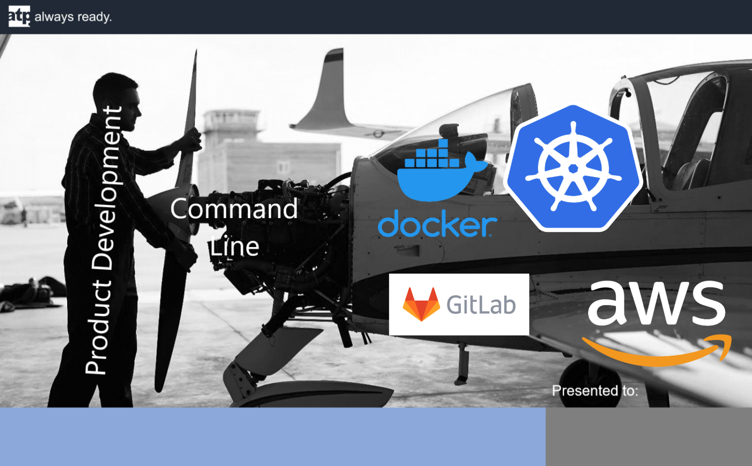

Kubernetes, Helm & Gitlab – Part 1
{{ .Values.date }}

Slide 2
Agenda
Part 1 (today)
Kubernetes and Helm big picture
Overview of common Kubernetes objects & keywords
Useful commands
Work-Center object topology
Demos!
Part 2: GitLab
Work-Center CI/CD overview
How GitLab uses Docker, Kubernetes, Helm & EKS
TODO: complete part 2 agenda.

Slide 3
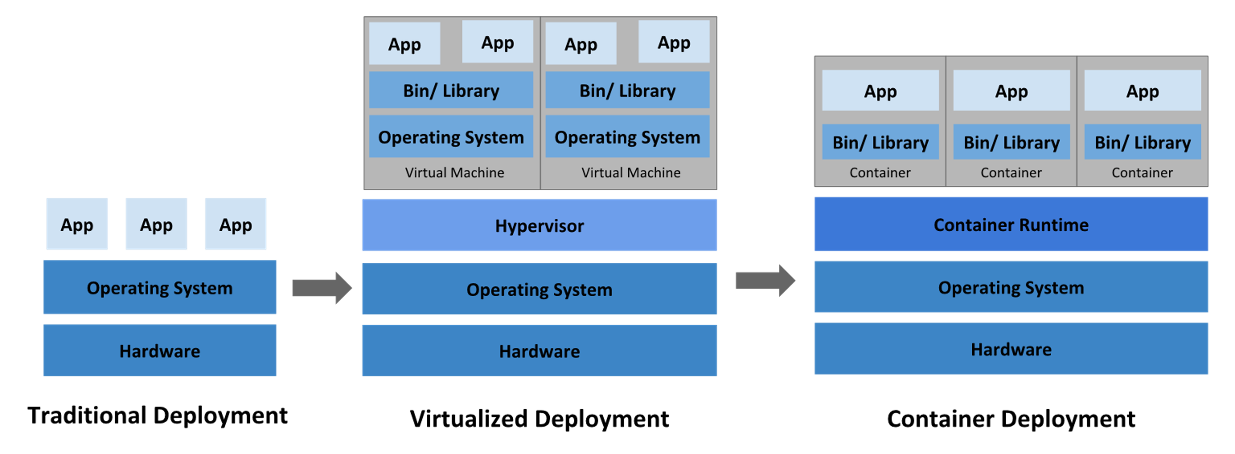
Deployments, a history

Slide 4
Kubernetes – Big picture
"Kubernetes is a portable, extensible, open-source platform for managing containerized workloads and services, that facilitates both declarative configuration and automation."
...
"Kubernetes provides you with a framework to run distributed systems resiliently. It takes care of scaling and failover for your application, provides deployment patterns, and more."
https://kubernetes.io/docs/concepts/overview/what-is-kubernetes/

Slide 5
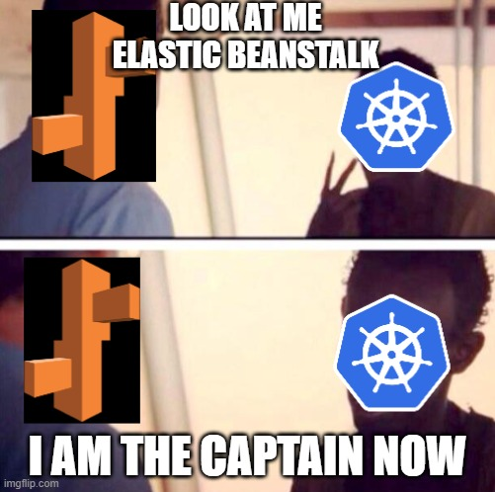

Slide 6
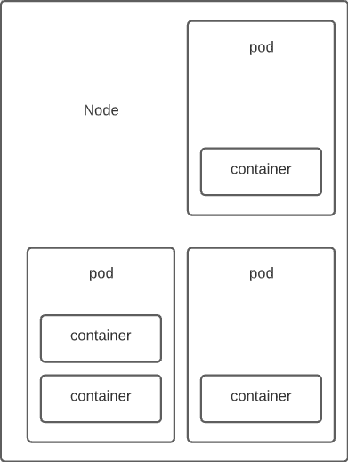
Kubernetes basics – Pods, Nodes, Containers
Node:
Can be a physical machine or virtual machine
Each is managed by the Control Plane and contains necessary services to run pods
Managed by the EKS NodeGroup configuration
In EKS, a node is an EC2 instance

Slide 7
Kubernetes basics – Pods, Nodes, Containers
Pod:
Pods are the smallest deployable units of computing that you can create and manage in Kubernetes
Can run one container or multiple containers that are tightly coupled.
Example OSBA sidecar (open service broker for azure)
Container:
Ready-to-run software package, containing everything needed to run an application: the code and any runtime it requires, application and system libraries, and default values for any essential settings

Slide 8
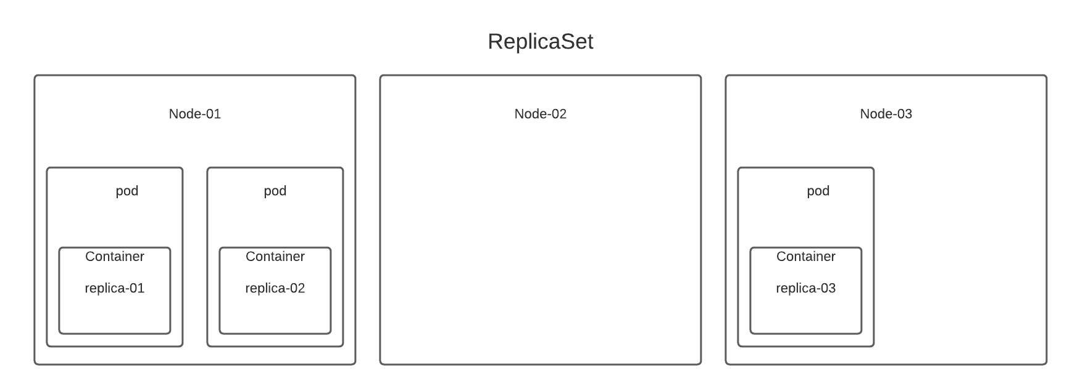
Kubernetes Objects – ReplicaSet, Deployment, StatefulSet, DaemonSet
ReplicaSet:
Maintain a stable set of replica Pods running at any given time
Purpose is to guarantee availability of the pods
Documentation recommends not using ReplicaSets directly and instead using a Deployment unless custom orchestration is needed
Example: WorkCenter API

Slide 9
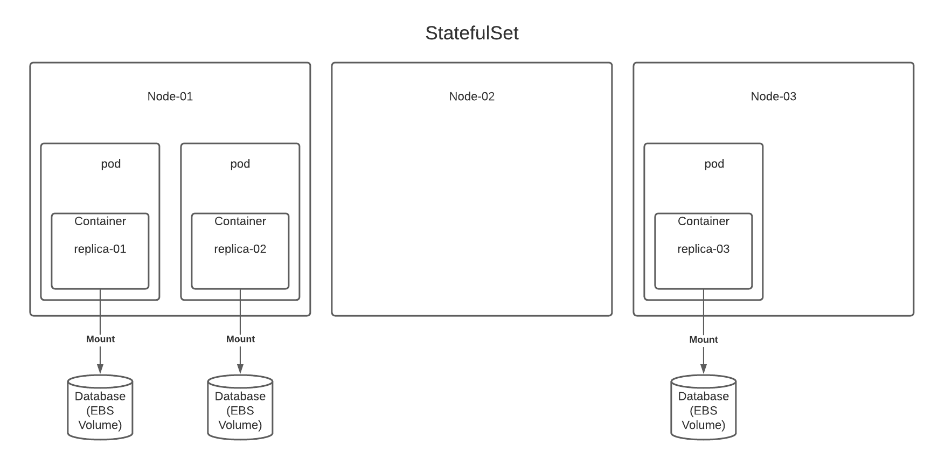
Kubernetes Objects – ReplicaSet, Deployment, StatefulSet, DaemonSet
StatefulSet:
Workload object used to manage stateful applications
Example: RabbitMQ + Elastic Block Storage

Slide 10
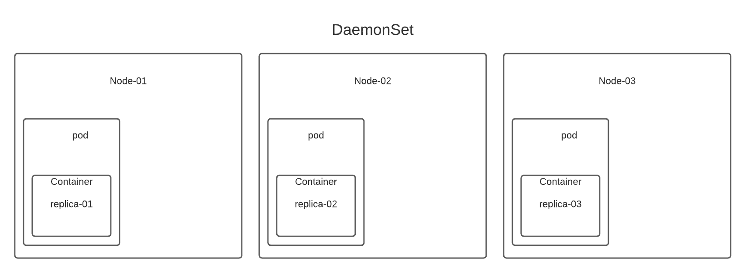
Kubernetes Objects – ReplicaSet, Deployment, StatefulSet, DaemonSet
DaemonSet:
Ensures that all (or some) Nodes run a copy of a Pod
Example: Twistlock / Antivirus / Node Monitoring & logging

Slide 11
Kubernetes Objects – ReplicaSet, Deployment, StatefulSet, DaemonSet
Deployment:
Provides declarative updates for Pods and ReplicaSets
Example: WorkCenter API

Slide 12
Kubernetes Objects - Service
Abstract way to expose an application running on a set of Pods as a network service
As pods are created and destroyed, services are able to route traffic to new instances using a label matching system.

Slide 13
Kubernetes Objects - Service
Types of services:
ClusterIP: Exposes the Service on a cluster-internal IP. Choosing this value makes the Service only reachable from within the cluster. This is the default ServiceType.
NodePort: Exposes the Service on each Node's IP at a static port (the NodePort). A ClusterIP Service, to which the NodePort Service routes, is automatically created. You'll be able to contact the NodePort Service, from outside the cluster, by requesting <NodeIP>:<NodePort>.
LoadBalancer: Exposes the Service externally using a cloud provider's load balancer. NodePort and ClusterIP Services, to which the external load balancer routes, are automatically created.
ExternalName: Maps the Service to the contents of the externalName field (e.g. foo.bar.example.com), by returning a CNAME record with its value. No proxying of any kind is set up.

Slide 14
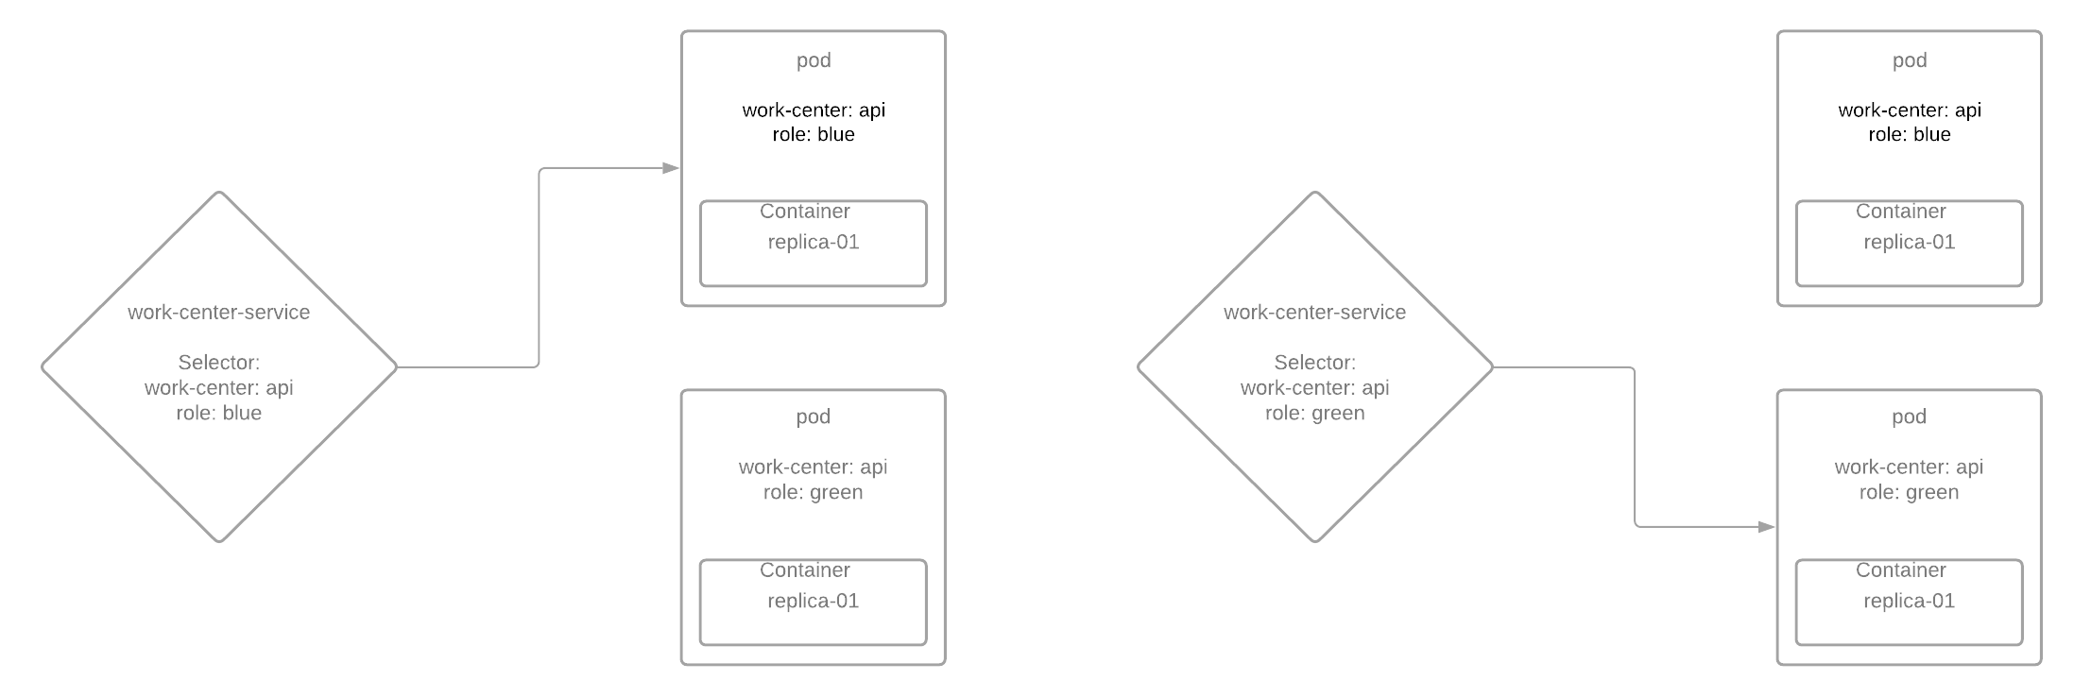
Kubernetes Objects - Service

Slide 15
Kubernetes Objects - Ingress
An API object that manages external access to the services in a cluster, typically HTTP
Ingress may provide load balancing, SSL termination and name-based virtual hosting
You must have an Ingress controller to satisfy an Ingress. Only creating an Ingress resource has no effect
Examples
Kubernetes as a project supports and maintains AWS, GCE, and nginx ingress controllers

Slide 16
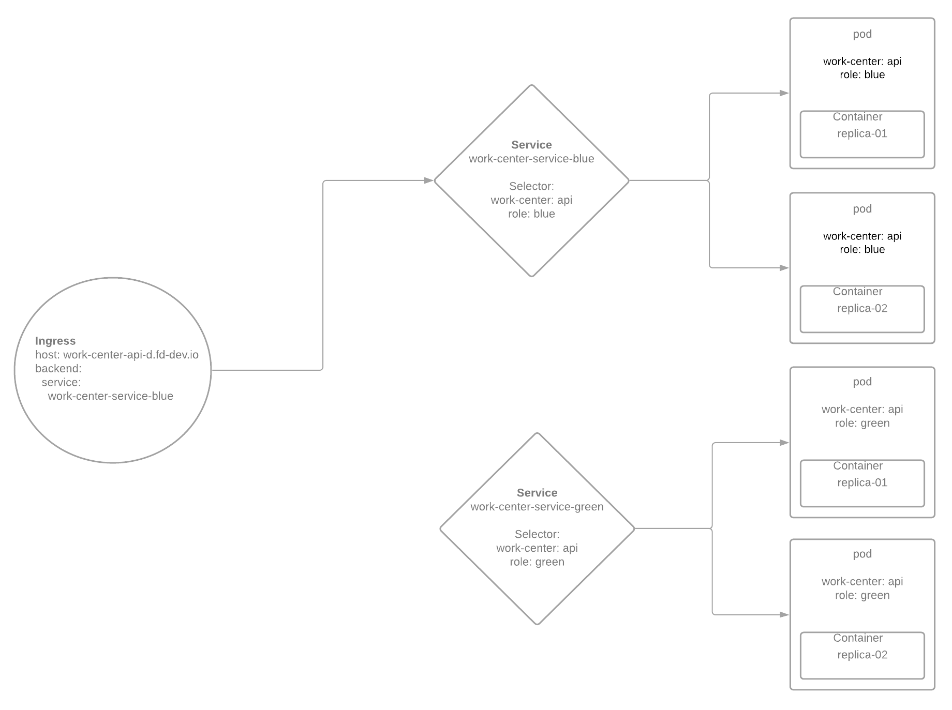
Kubernetes Objects – Ingress
Blue - Prod
Green - Successor

Slide 17
Kubernetes Objects – ConfigMap
A ConfigMap is an API object used to store non-confidential data in key-value pairs. Pods can consume ConfigMaps as environment variables, command-line arguments, or as configuration files in a volume.
A ConfigMap allows you to decouple environment-specific configuration from your container images, so that your applications are easily portable.
Not designed to hold large chunks of data. The data stored in a ConfigMap cannot exceed 1 MiB.

Slide 18
Kubernetes Objects – Secret
A Secret is an object that contains a small amount of sensitive data such as a password, a token, or a key
Secrets are similar to ConfigMaps but are specifically intended to hold confidential data.

Slide 19
Kubernetes Commands - help
Scenario: You’re totally stuck
Command: kubectl –h
Scenario: You don’t know what objects are available
Command: kubectl api-resources
Scenario: You have an object, but you don’t know how to use it or define it
Command: kubectl explain <object-name>
Scenario: You have an object, but you need to know more about one of it’s properties
Command: kubectl explain <object-name>.<property-name>

Slide 20
Kubernetes Commands - Context
Understand your current context. Very Important!!
kubectl config current-context
View your kubeconfig
kubectl config view
Config file lives at ~/.kube/config (WSL)
Works closely with your AWS CLI config
(WSL) ~/.aws/config & ~/.aws/credentials
Change the kubectl context
kubectl config use-context <context-name>

Slide 21
Kubernetes Commands - Context
Demo kubectl configuration & context

Slide 22
Kubernetes Commands - Apply
Create/Apply changes to objects defined in yaml file
kubectl apply –f <filename.yaml>
Ex: kubectl apply –f deployment.yaml
--dry-run
Allows for testing the apply command before actually performing the work.
Delete an object defined in yaml file
kubectl delete –f <filename.yaml>

Slide 23
Kubernetes Commands - Apply
Demo 2048 game deployment

Slide 24
Kubernetes Commands - Debugging
Show details of a specific resource or group of resources
kubectl describe <object-type> <object-name>
Ex: kubectl describe pod work-center-dev-01
Show stdout error logs for a container running in a pod
kubectl logs <pod-name>
Ex: kubectl logs work-center-dev-01

Slide 25
Kubernetes Commands - Debugging
Demo debugging

Slide 26
Kubernetes Connecting to a Pod
Kubernetes assigns an IP Address and DNS name to each pod
Connect to a pod directly using
kubectl port-forward <pod-name> <local-port>:<pod-port>
kubectl port-forward deployment/<deployment-name> <local-port>:<pod-port>
Not a good long-term solution, requires an open command window
Connect using a service object (2048 example)
Connect using Ingress and Service objects (work-center)

Slide 27
Kubernetes Connecting to a Pod
Demo Port Forwarding & Services

Slide 28
Kubernetes – Different Environments
Suppose you have 3 environments: dev, stg, prod. You could easily end up with the following file structure:
Assets/
dev/
service.yaml
deployment.yaml
…
stg/
service.yaml
deployment.yaml
…
prod/
service.yaml
deployment.yaml
…
= Hard to maintain ☹
Q: What should we do?
A: Abstract this concept away from being managed in Kubernetes

Slide 29


Slide 30
Helm – Big Picture
Helm is a tool for managing Kubernetes packages called charts.
The Helm Library provides the logic for executing all Helm operations. It interfaces with the Kubernetes API server and provides the following capability
Combining a chart and configuration to build a release
Installing charts into Kubernetes, and providing the subsequent release object
Upgrading and uninstalling charts by interacting with Kubernetes
Helm uses a packaging format called charts. A chart is a collection of files that describe a related set of Kubernetes resources. A single chart might be used to deploy something simple, like a memcached pod, or something complex, like a full web app stack with HTTP servers, databases, caches, and so on

Slide 31
Helm – Repositories
List Helm repositories
helm repo ls
Add repository
helm repo add <repo-name> <repo-url>
Update all repositories
helm repo update
Search a repository by keyword
helm search repo rabbitmq
https://artifacthub.io/packages/helm/bitnami/rabbitmq

Slide 32
Helm – Chart Files
Chart.yaml
Some basic information about the chart (name, version, etc)
Required for a helm chart
Template files
The Kubernetes objects that will be managed
Template files follow the standard conventions for writing Go templates (see the text/template Go package documentation for details
Values file
Considering a template/set of templates, the values.yaml file supplies the necessary default values.

Slide 33
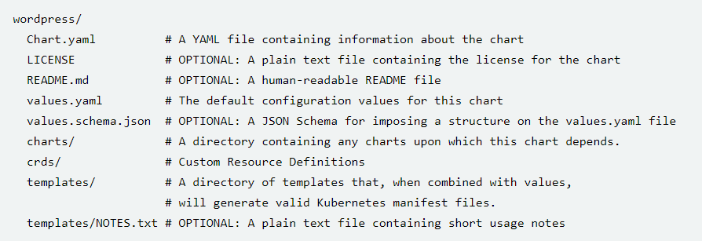
Helm – Chart File Structure

Slide 34
Helm – Repositories continued
Show details of a chart
helm show all bitnami/rabbitmq
Allows you to specify a version with –version
Fetch the package from the repository
Extremely useful command to understand what the chart looks like
helm fetch bitnami/rabbitmq --version 8.4.1

Slide 35
Helm – Chart commands
Install a chart
helm install <chart-name> <path-to-chart-directory>
-n <namespace>
-f <values-file>
Uninstall a chart
helm uninstall <chart-name>
-n <namespace>
Upgrade a chart
helm upgrade --install <chart-name> <path-to-chart-directory>
-n <namespace>
-f <values-file>

Slide 36
Helm – Chart
Demo helm chart

Slide 37
Helm – Chart
Again, we end up with a similar file structure when considering multiple environments:
helm/
Chart.yaml
templates/
service.yaml
deployment.yaml
values.yaml
values-dev.yaml
values-prod.yaml
= Easier than before, but still hard to maintain. ☹
Q: What do we do?
A: Abstract this concept away from being managed by Helm.

Slide 38


Slide 39
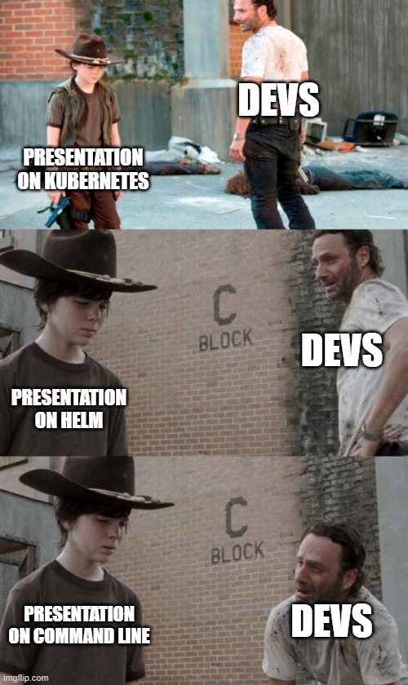
BASH – ?

Slide 40
BASH – env substitute
envsubst is a command included in the gettext-base command line utility. It allows us to substitute command line variables into text file templates using special syntax.

Slide 41
BASH – envsubst
Demo envsubst

Slide 42
Questions?

